Slide 1
Drupal Community in China
Liang Shen

Slide 2
Who am I? @shenzhuxi
Drupal developer in European Bioinformatics Institute
Maintainer of modules on Drupal.org
apachesolr_user_indexer
apachesolr_file
pdf
og_moderation
og_workflow
fileviewer
highlight
Notes:
Introduction

Slide 3
Drupal China Community
Beijing
Shanghai
Guangzhou
Chongqing
Xi'an
Hongkong
...

Slide 4
Guangzhou 2009

Slide 5
Shanghai 2009

Slide 6
Beijing 2010

Slide 7
Beijing 2011

Slide 8
Drupal China Community
DrupalChina.org (shut down)
DrupalCHN.org (almost shut down)
groups.drupal.org
QQ Group
Notes:
shut down at the end of 2010

Slide 9
QQ Group

Slide 10
Contribution from China
Notes:
Google: "china" "commit" site:drupal.org/user

Slide 11
DrupalCon Scholars from China
skyredwang, San Francisco, 2010
makara, Copenhagen, 2010
shenzhuxi, London, 2011
willkaxu, Denver, 2012
?, Munich, 2012

Slide 12
Companies
Beijing
Shanghai
Notes:
Strength 1: growth
Foreign Language Teaching and Research Press

Slide 13
Weakness
Language
Living Standard
Legal Environment:
Piracy
Censorship
Education
Notes:
Weakness

Slide 14
Developers/Language
Use English
Developers
PHP
Drupal
Read English
Notes:
Weakness 1: Language

Slide 15
Browser Hell
Notes:
Weakness 2: Piracy
(Red hot IE6 country)

Slide 16
Great Fire Wall
Why Linux goes from 2.6.3 to 3.0.0 directly?
Notes:
Weakness 3: Censorship
Joke
Python 2.6.4 download link was blocked.
Github.com is blocked since March 2012!

Slide 17
Opportunities
Where?
Startup
E-Commerce
Enterprise
NGO
Mobile
How?
eChinaCities.com
CRbook.cn
Edanz group
CNCdiversitas.org
greatbrewers.com?
Notes:
Opportunities

Slide 18
Competitors
"Free"
Localization
"Open source" BBS
by comsenz (acquired by Tencent)
Notes:
Threat

Slide 19
SWOT
Strengths - Price? - Labor Force - Quality? - Retention | Weakness - Communication - Demand >Supply - Labor availability - Education - Entrepreneurs - Support - Closed economy
Opportunities - Growth - Non-digital space - Huge local opportunity | Threats - Lost opportunity - Censorship? - Brain drain/Movement of labor
Notes:
Is quality a strength?
Is censorship a threat or weakness?
Price (Strength) sense market?

Slide 20
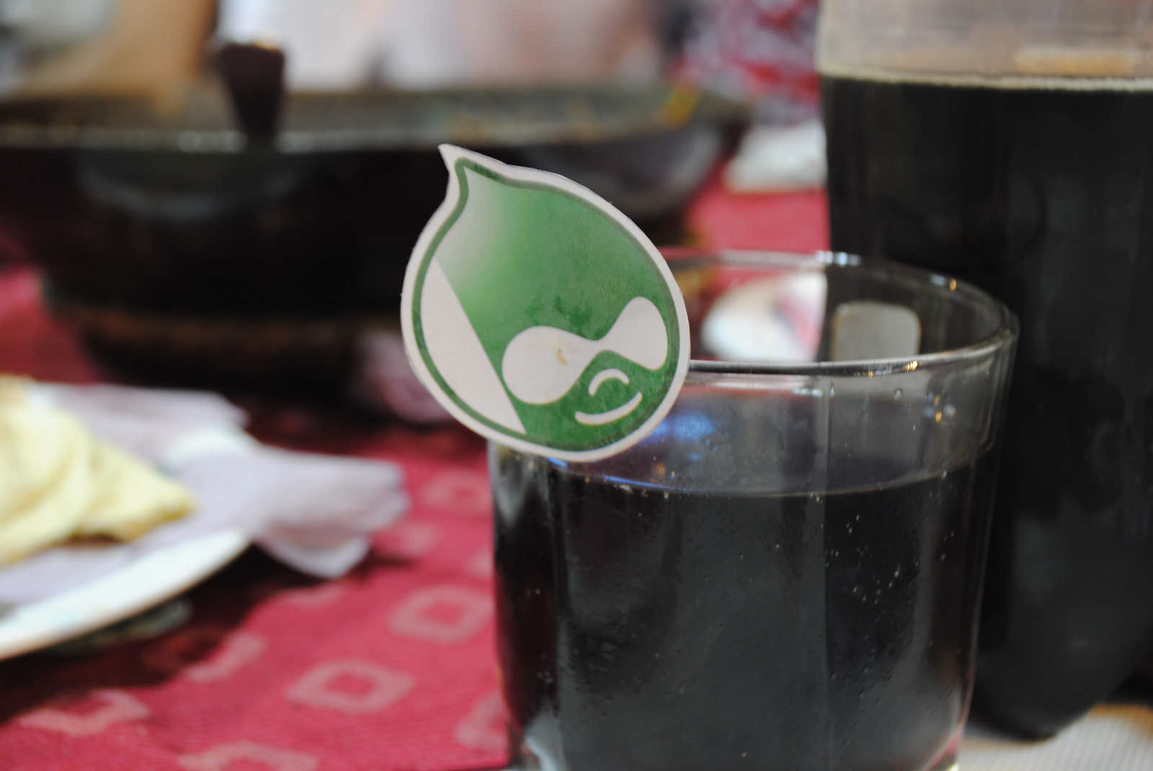
Drupal in Pakistan
…runs on Coke®
Kubair Shirazee

Slide 21
Pakistan!?
10.4% of the population is connected (18,500,000 internet users 2010 figures)
57% Mobile penetration.
47th largest economy in the world.
54% of the economy is service based.
Worth of local software services industry is US$1.2 billion.
Pakistan is the second easiest place to do business with in South Asia, it has more English speakers than, South Africa, Turkey, Singapore or Malaysia.

Slide 22
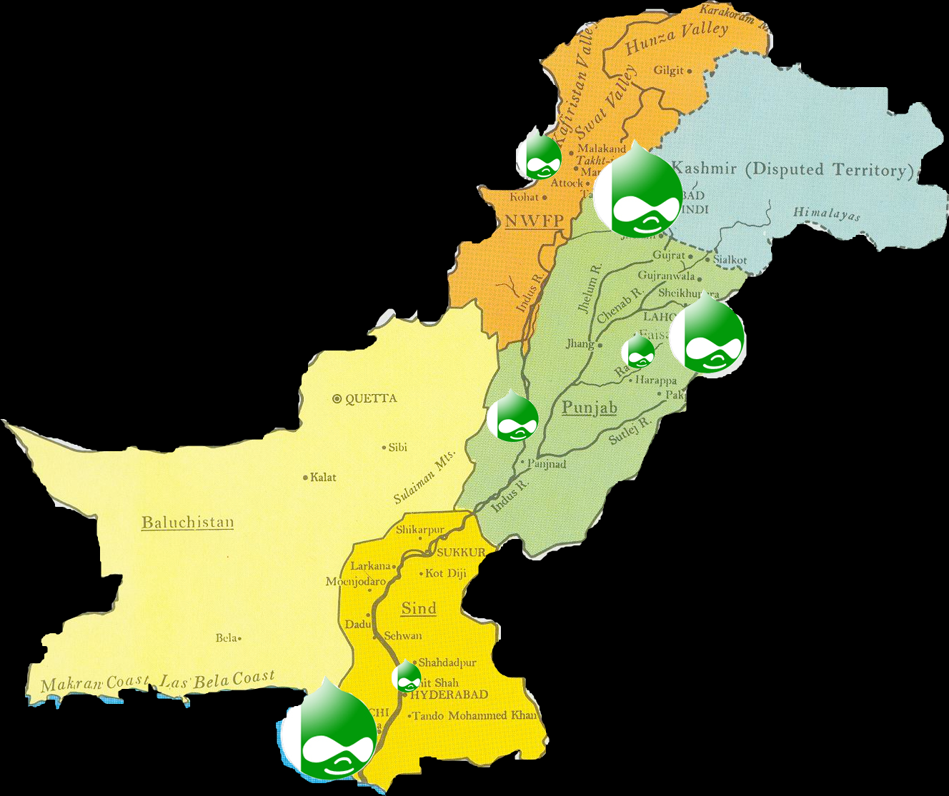
Drupal Community in Pakistan

Slide 23
Drupal in Pakistan
First Drupal tar downloaded in 2004
Community active on D.O since 2006
Registered Drupal members from Pakistan, as of April 2012; is 5,421
Active members are a small proportion of the registered base.
In the top ten countries by growth in visits to Drupal.org in 2010 and 2011
Fourth highest growth region in visitors to D.O from 2010-2011 from Southern Asia

Slide 24
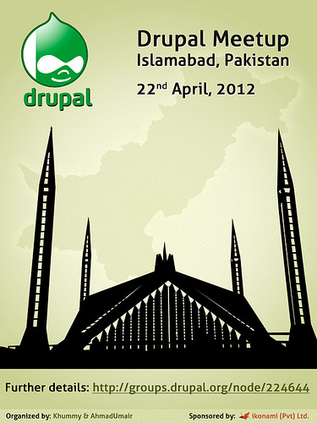
Drupal Community in Pakistan
Registered Drupal members from Pakistan, as of April 2012; is 5,421
Active members are a small proportion of the registered base.
Rallying the community has been a tall order but the ice has been broken
First Drupal Meet up took place in April 2012
To be followed by a Drupal camp in June 2012

Slide 25
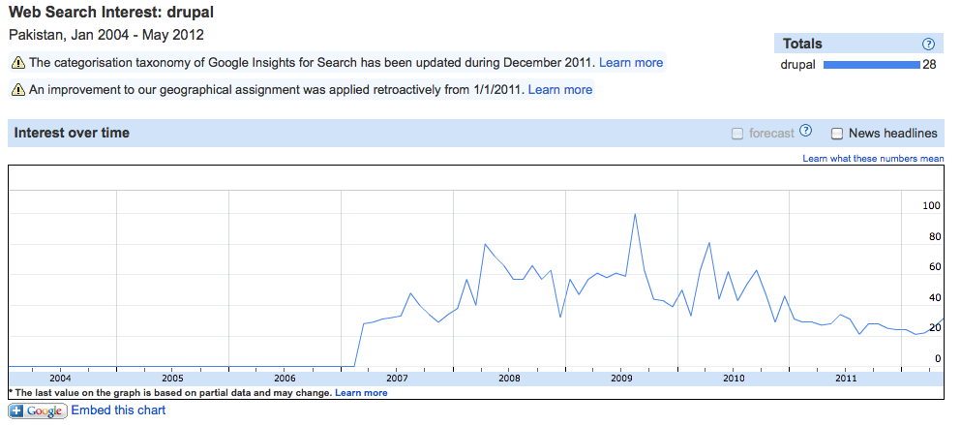
Interest in Drupal – the insight!

Slide 26
Potential for Drupal in Pakistan
Small number of Public & Private sector institutions are using Drupal, the potential for Drupal’s adoption across the indigenous digital economy is huge. indigenous digital economy is worth US $1.2 billion.
Positives:
A sizeable contingent of Drupal front end and backend development engineers
Growing digital economy
Growing momentum towards e-Governance
Attrition not as big an issue as other digital economies
Challenges:
Export driven service market: skills are export focused
Passive Drupal community with a miniscule proportion engaged with the wider community
Lack of indigenous Drupal training providers (only 3!)
Keeping the momentum consistent
A lack of promotion of Open Source at governmental and institutional levels

Slide 27
Biggest Challenge…
…is the Mindset!... Of the local Drupal Community itself!
…it is a PLATFORM for awesome Applications not a just a CMS!

Slide 28
Opportunities in Pakistan… Where are they
HOT PROSPECTS
Public Sector
NGO sector
Educational institutions
TOUGH COOKIES
SME
Large corporates
(Microsoft, Oracle and SAP heaven!)
NEED TO CREATE AWARENESS ACROSS THE BOARD
In the market & in the community

Slide 29
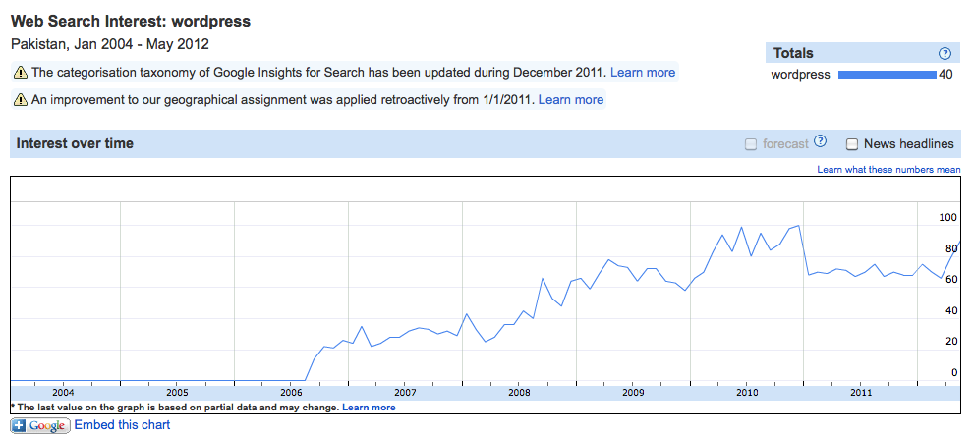
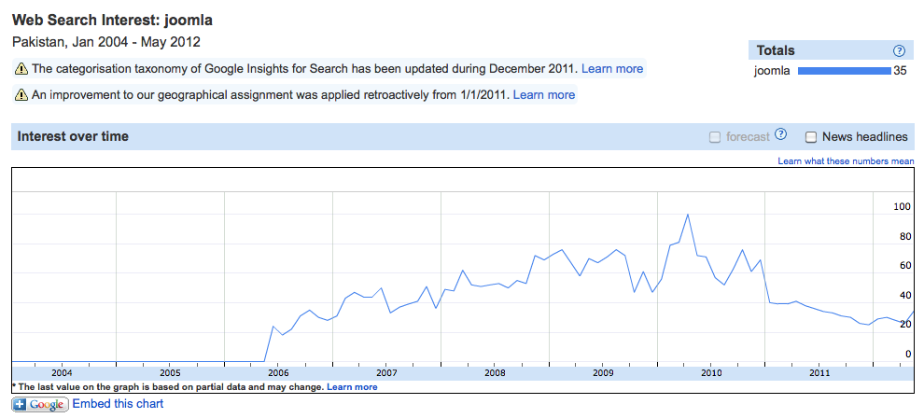
But… the competition is from…
Competition for OS projects is from Wordpress and Joomla

Slide 30
Growing Drupal in Pakistan
INTERACTIVE SECTION
1) At this point a couple of Drupal developers will very briefly introduce themselves– there is a contingent of 6-8 developers attending the conference from Pakistan. There were a total 3 from Pakistan at DrupalCon London 2011. Providing a macro view of the community in Pakistan.
The Drupalistas from Pakistan will take questions from the floor and share their experiences.
2) The developer who first download Drupal tar in 2004 will Skype in if possible to provide a macro view of the community from his perspective as a OS and Drupal proponent.
Questions to put to the audience:
What support can Acquia and the Drupal Association provide to truly capitalize the opportunity for Drupal in Pakistan. The suggestions would be noted and would form the basis of a conversation with Acquia and Drupal Association at the Conference.

Slide 31
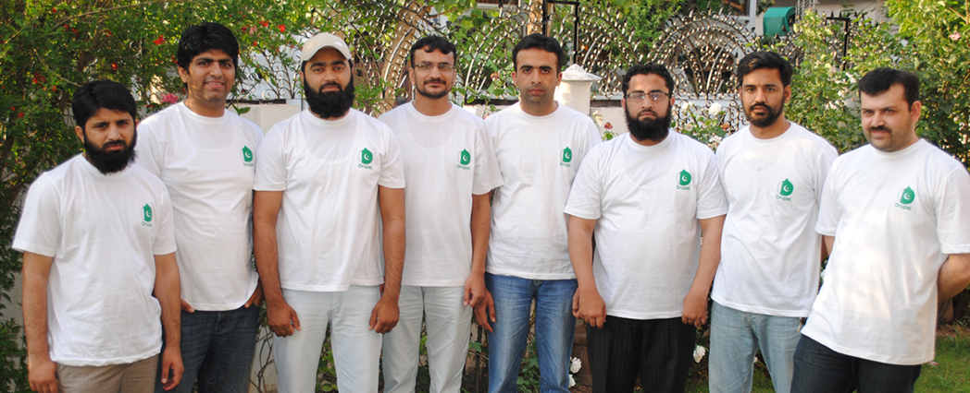
From Pakistan with love… for Drupal
Some of us are right here at DrupalCon Munich… lets chat!

Slide 32
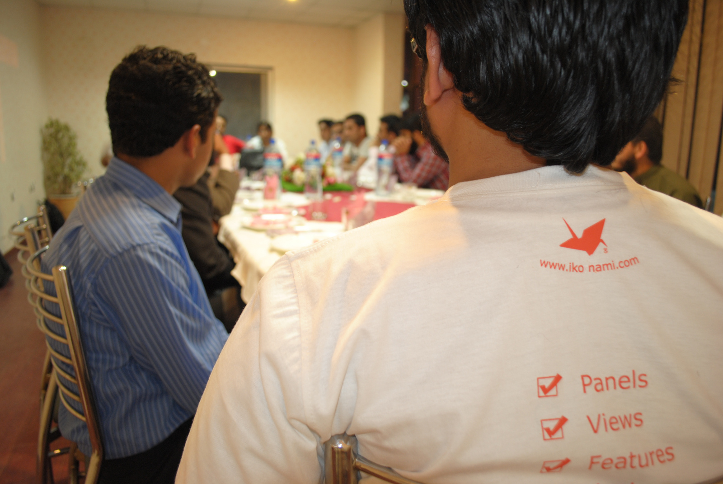
From Pakistan with love… for Drupal
Some of us are right here at DrupalCon Munich… lets chat!

Slide 33
Questions?
@shenzhuxi
&
@kubair

Slide 34
Questions?
@shenzhuxi

